Slide 1
Chapter 10: Loops, Additional Controls, Manipulating CSS with JavaScript

Slide 2
Chapter 10 – Loops, Additional Controls, Manipulating CSS with JavaScript
while Loop
External JavaScript Files
Compound Interest Calculator
JavaScript Debugging
do Loop
Radio Buttons
Checkboxes
for Loop
fieldset and legend Elements
Font Styles Web Page

Slide 3
Chapter 10 – Loops, Additional Controls, Manipulating CSS with JavaScript
Manipulating CSS with JavaScript
style Property
Using z-index to Stack Elements on Top of Each Other
Relative Positioning
Global Variables
Text Area Control
List Boxes
Pull-Down Menus
Popup Menus

Slide 4
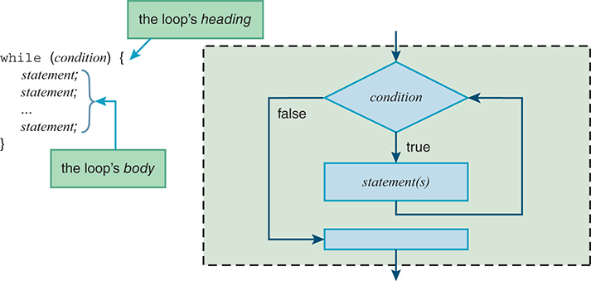
while Loop (1 of 2)
Use a loop statement if you need to do the same thing repeatedly.

Slide 5
while Loop (2 of 2)
Loop terminology:
The number of times that the loop repeats is called the number of iterations.
It's possible for a loop to repeat forever. That's called an infinite loop. (Note: It's also possible for a loop to repeat zero times.)
Note the following code fragment that uses a while loop to calculate the factorial of a user-entered number:
if (numBox.checkValidity()) {
num = numBox.valueAsNumber;
factorial = 1;
count = 2;
while (count <= num) {
factorial *= count;
count++;
}
document.getElementById("result").innerHTML =
num + "! = " + factorial;
} // end if

Slide 6
External JavaScript Files (1 of 2)
As an alternative to positioning a JavaScript function within a web page's head container, it's legal to position it in an external file and have the web page link to that file.
What are the advantages of positioning a web page's JavaScript functions in an external file?
If another web page needs the functionality provided by one of the functions, the second web page can link to the external file and share the function. By using the already-written function, the second web page doesn't have to "reinvent the wheel."
If an external JavaScript file is shared by multiple web pages, maintenance (i.e., fixing bugs and making improvements) becomes easier and storage requirements are reduced.

Slide 7
External JavaScript Files (2 of 2)
To implement an external JavaScript file:
In your web page, include an empty script container with a src attribute that specifies the location of a .js JavaScript file. For example:
<script src="compoundInterest.js"></script>
The above src value specifies that the JavaScript file is stored in the same directory as the HTML file. If you store the JavaScript file elsewhere, then use a path as part of the src's value.
In the JavaScript file, include the following:
Documentation comments, including a prologue at the top
Code for your function definitions

Slide 8
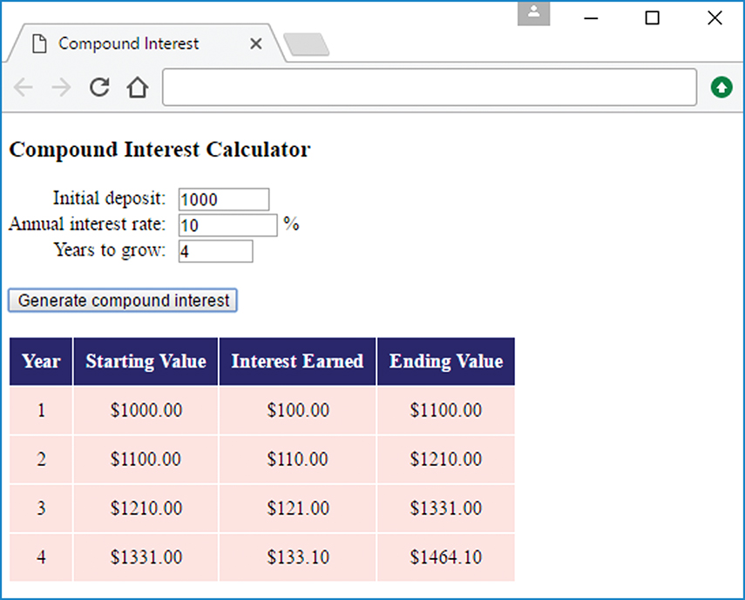
Compound Interest Web Page
The Compound Interest web page generates a table of compound interest values for a user-specified number of years.

Slide 9
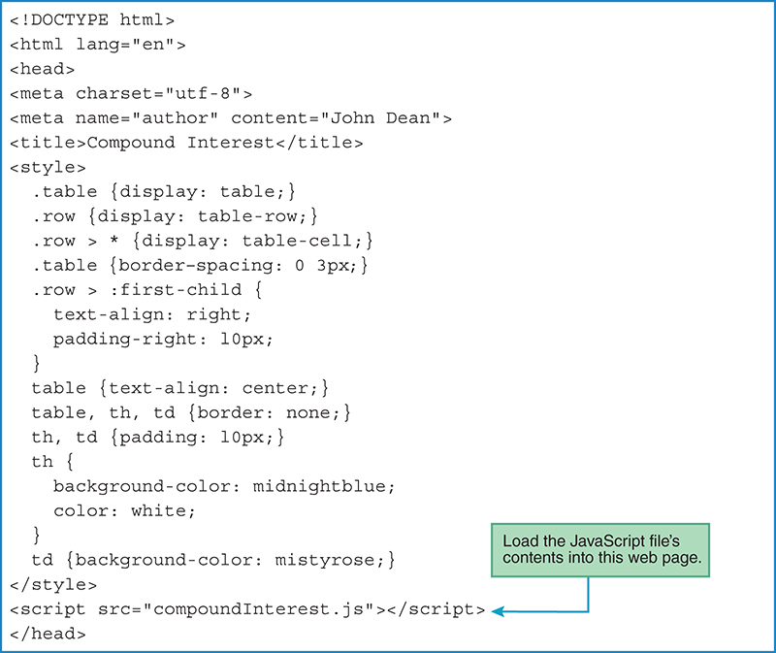
Compound Interest Web Page - head Container

Slide 10
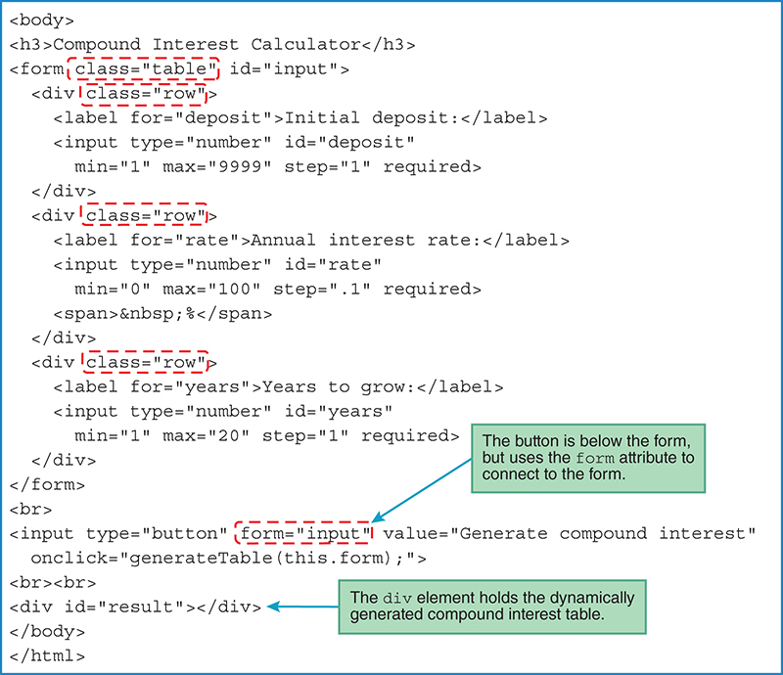
Compound Interest Web Page - body Container

Slide 11
Compound Interest Web Page - JavaScript File (1 of 2)
/*******************************************************
* compoundInterest.js
* John Dean
*
* This file contains a function that supports the
* compound interest web page.
*******************************************************/
// This function generates a compound interest table.
function generateTable(form) {
var amount; // accumulated value for each new year
var rate; // interest rate
var years; // years for principal to grow
var interest; // interest earned each year
var table; // compound interest table
var year = 1; // the year being calculated
amount = form.elements["deposit"].valueAsNumber;
rate = form.elements["rate"].valueAsNumber;
years = form.elements["years"].valueAsNumber;

Slide 12
Compound Interest Web Page - JavaScript File (2 of 2)
table =
"<table>" +
"<tr><th>Year</th><th>Starting Value</th>" +
"<th>Interest Earned</th><th>Ending Value</th></tr>";
while (year <= years) {
table += "<tr>";
table += "<td>" + year + "</td>";
table += "<td>$" + amount.toFixed(2) + "</td>";
interest = amount * rate / 100;
table += "<td>$" + interest.toFixed(2) + "</td>";
amount += interest;
table += "<td>$" + amount.toFixed(2) + "</td>";
table += "</tr>";
year++;
} // end while
table += "</table>";
document.getElementById("result").innerHTML = table;
} // end generateTable

Slide 13
JavaScript Debugging
All of the major browsers have debugging tools built in.
Chrome's debugging tool is called "Developer Tools." To load it, press ctrl+shift+j.
To get practice using Chrome's JavaScript developer Tools, use the Chrome Developer Tools tutorial, which uses the Compound Interest web page.

Slide 14
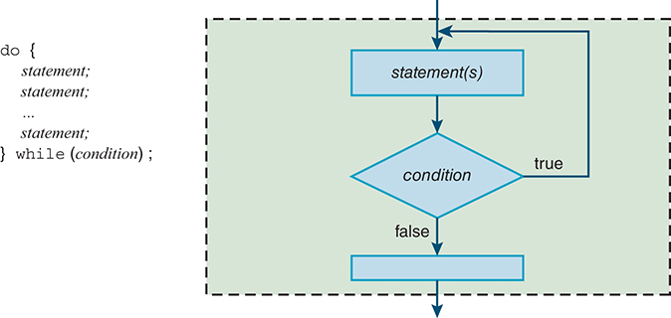
do Loop
Use a do loop statement when you’re sure that the loop body should be executed at least one time.

Slide 15
Radio Buttons (1 of 4)
Radio button control interface:
Radio buttons come in a group. When one of the buttons in the group is clicked, it gets selected/highlighted and the other buttons get unselected.
Simplified radio button control syntax:
<input type="radio"
name="button-group-name"
value="button’s-value"
checked>
Example with three radio button controls:
<input type="radio" name="color" value="black">Black
&nbsp;&nbsp;
<input type="radio" name="color" value="pistachio">Pistachio
&nbsp;&nbsp;
<input type="radio" name="color" value="indigoBlue">Indigo Blue

Slide 16
Radio Buttons (2 of 4)
As with text controls, use label elements if you’d like your web page to be accessible to the visually impaired:
Radio button control attributes:
name
Provides a name for the radio buttons' group so the buttons can be accessed with JavaScript
Why is a common button group name required?
value
Specifies the individual button's value. Used by JavaScript to know what the user selected.
checked
If the checked attribute is present, then the radio button is preselected.
The default is for the radio button to not be selected.
onclick event handler attribute
Whenever the radio button is clicked, the browser engine executes the onclick event handler code.

Slide 17
Radio Buttons (3 of 4)
To retrieve a collection of radio buttons, use this JavaScript:
radio-button-collection = form.elements["button-group's-name"];
Radio button collection properties
radio-button-collection.value
Returns the selected radio button's value
If a collection of radio buttons has no button selected, then the value property returns the empty string.
radio-button-collection.length
Returns the number of buttons in the radio button collection

Slide 18
Radio Buttons (4 of 4)
A collection is a group of values. Some collections have values that are ordered sequentially, and those values can be accessed using collection[index] notation, where an index value of 0 refers to the first object in the collection.
Radio button properties
radio-button-collection[i].value
Returns/assigns the i^{th} radio button's value
radio-button-collection[i].defaultChecked
Returns true or false, for whether the i^{th} button was preselected
radio-button-collection[i].checked
Returns/assigns true or false, for whether the i^{th} button is currently selected
radio-button-collection[i].disabled
Returns/assigns true or false, for whether the i^{th} button is disabled

Slide 19
Checkboxes (1 of 4)
Check box control interface:
When a checkbox is clicked, a check appears in the checkbox. When the checkbox is clicked again, the check disappears.
Simplified checkbox control syntax:
<input type="checkbox"
id="check-box-name"
name="check-box-group-name"
value="check-box’s-value"
checked
onclick="check-box-event-handler">
Example with one checkbox:
I accept the terms and conditions of this agreement:
<input type="checkbox" id="accept-terms" checked
onclick="acceptTerms(this.form);">
Example with a group of checkboxes:
<input type="checkbox" name="jobSkills" value="HTML5">know HTML5<br>
<input type="checkbox" name="jobSkills" value="CSS">know CSS<br>
<input type="checkbox" name="jobSkills" value="goodCoffee">
make good coffee

Slide 20
Checkboxes (2 of 4)
Checkbox control attributes:
id
Provides an identifier for the checkbox, so it can be accessed with JavaScript
The HTML5 standard does not allow spaces within id values. If you want to use multiple words for an id value, use hyphens to separate the words.
name
Provides a name for a group of checkboxes. JavaScript can use the name to retrieve the group of same-named checkboxes and access the individual checkboxes by looping through the group.
value
Specifies the individual checkbox's value. Used by JavaScript to know what the user selected
checked
If the checked attribute is present, then the checkbox is preselected.
The default is for the checkbox to not be selected.
onclick event handler attribute:
Whenever the checkbox is clicked, the browser engine executes the onclick event handler code.

Slide 21
Checkboxes (3 of 4)
To retrieve a stand-alone checkbox, use this JavaScript:
checkbox-control = form.elements["checkbox-id"];
To retrieve a collection of checkboxes, use this JavaScript:
checkbox-collection = form.elements["checkbox-group's-name"];
To access the individual checkboxes within a collection of checkboxes, use checkbox-collection[index] notation, where an index value of 0 refers to the first checkbox.

Slide 22
Checkboxes (4 of 4)
Checkbox collection properties:
checkbox-collection.length
Returns the number of checkboxes in the checkbox collection
Checkbox control properties:
checkbox.value
Returns/assigns the checkbox's value
checkbox.defaultChecked
Returns true or false, for whether the checkbox was preselected
checkbox.checked
Returns/assigns true or false, for whether the checkbox is currently selected
checkbox.disabled
Returns/assigns true or false, for whether the checkbox is disabled

Slide 23
for Loop
JavaScript supports several types of loops. The while loop is the most basic type of loop. The for loop is more complicated (sorry), but it provides more power with less code.
The for…of loop is more compact.

Slide 24
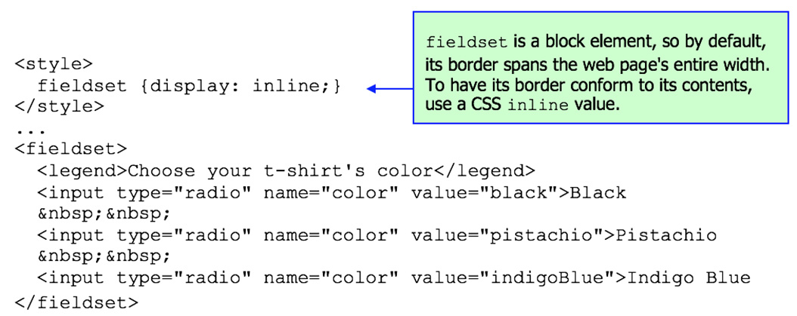
fieldset and legend Elements
If you'd like your radio buttons or checkboxes to be visually grouped, consider using the fieldset and legend elements. Here's an example with three radio button controls:

Slide 25
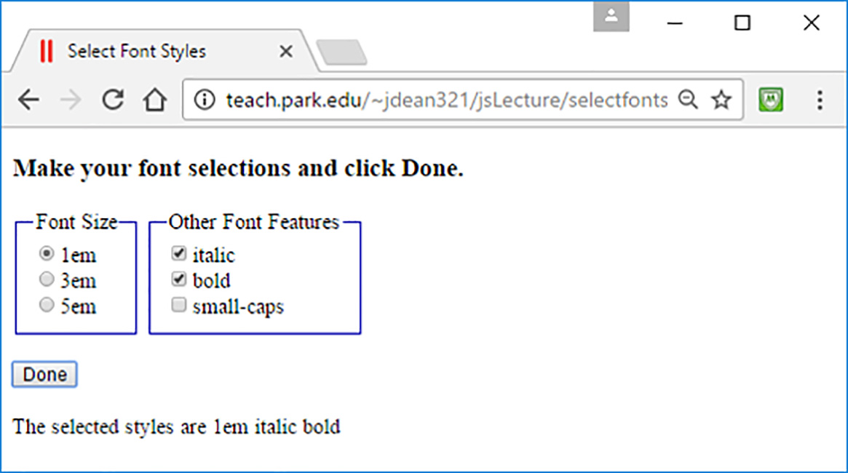
Font Styles Web Page (1 of 4)
The following first-cut Font Styles web page reads a user's font selections from radio button and checkbox controls and displays the selections as text.

Slide 26
Font Styles Web Page (2 of 4)
<!DOCTYPE html>
<html lang="en">
<head>
<meta charset="utf-8">
<meta name="author" content="John Dean">
<title>Select Font Styles</title>
<style>
fieldset {
display: inline;
border-color: blue;
}
</style>
<script>
// Display the user's selections.
function displaySelections(form) {
var fontSizeRBs; // collection of radio buttons
var fontFeatureCBs; // collection of checkboxes
var message; // resulting message

Slide 27
Font Styles Web Page (3 of 4)
message = "The selected styles are ";
fontSizeRBs = form.elements["fontSize"];
for (var i=0; i<fontSizeRBs.length; i++) {
if (fontSizeRBs[i].checked) {
message += fontSizeRBs[i].value + " ";
}
} // end for
fontFeatureCBs = form.elements["otherFontFeatures"];
for (var i=0; i<fontFeatureCBs.length; i++) {
if (fontFeatureCBs[i].checked) {
message += fontFeatureCBs[i].value + " ";
}
} // end for
document.getElementById("message").innerHTML = message;
} // end displaySelections
</script>
</head>

Slide 28
Font Styles Web Page (4 of 4)
<body>
<h3>Make your font selections and click Done.</h3>
<form>
<fieldset>
<legend>Font Size</legend>
<input type="radio" name="fontSize" value="1em" checked>1em<br>
<input type="radio" name="fontSize" value="3em">3em<br>
<input type="radio" name="fontSize" value="5em">5em
</fieldset>
<fieldset>
<legend>Other Font Features</legend>
<input type="checkbox" name="otherFontFeatures"
value="italic">italic<br>
<input type="checkbox" name="otherFontFeatures"
value="bold">bold<br>
<input type="checkbox" name="otherFontFeatures"
value="small-caps">small-caps
</fieldset>
<br><br>
<input type="button" value="Done" onclick="displaySelections(this.form);">
</form>
<div id="message"></div>
</body>
</html>

Slide 29
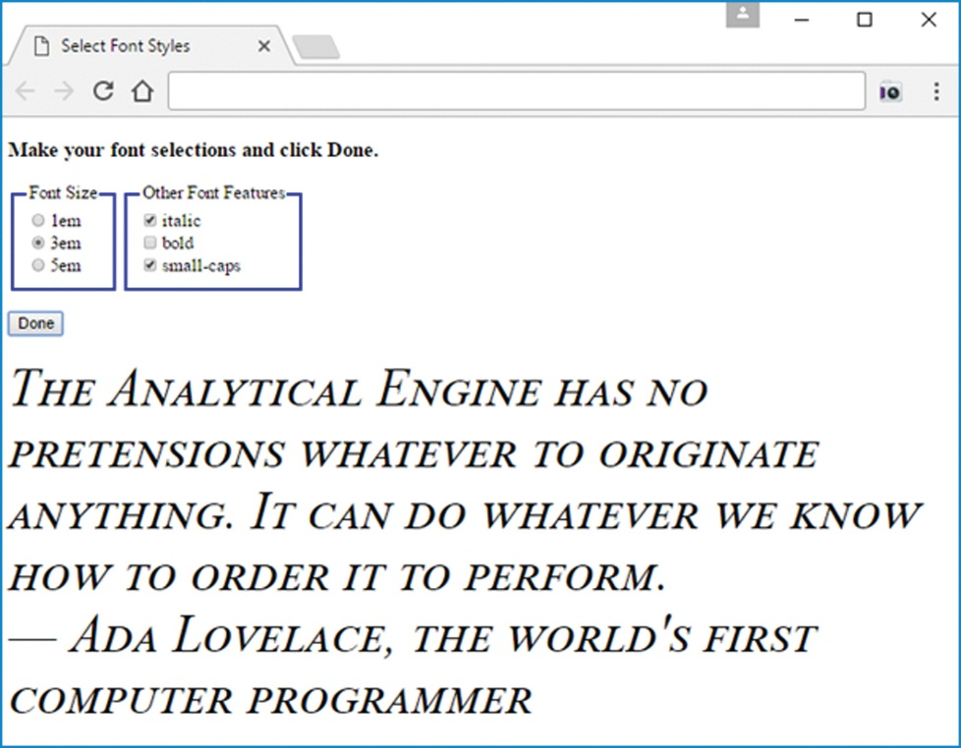
Font Styles Web Page - Enhanced Version
The following enhanced Font Styles web page applies a user's font selections to a message generated by the Done button.

Slide 30
Manipulating CSS with JavaScript (1 of 4)
<!DOCTYPE html>
<html lang="en">
<head>
<meta charset="utf-8">
<meta name="author" content="John Dean">
<title>Select Text Styles</title>
<style>
fieldset {
display: inline;
border-color: blue;
}
.hidden {display: none;}
.italic {font-style: italic;}
.bold {font-weight: bold;}
.small-caps {font-variant: small-caps;}
</style>
<script>
// Apply the user's font selections to text at the
// bottom of the web page.

Slide 31
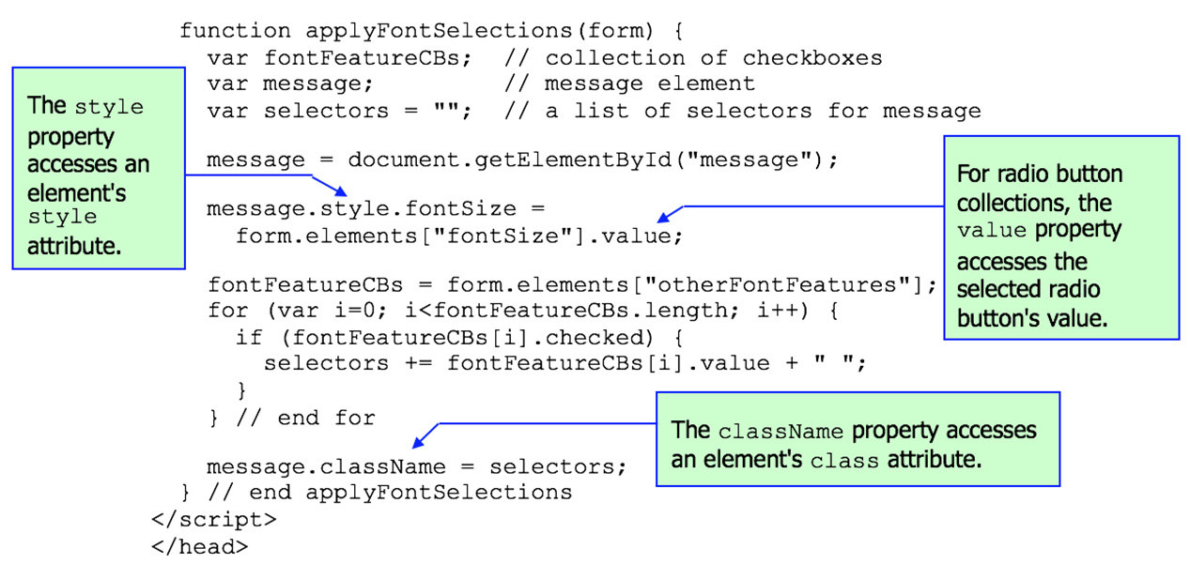
Manipulating CSS with JavaScript (2 of 4)

Slide 32
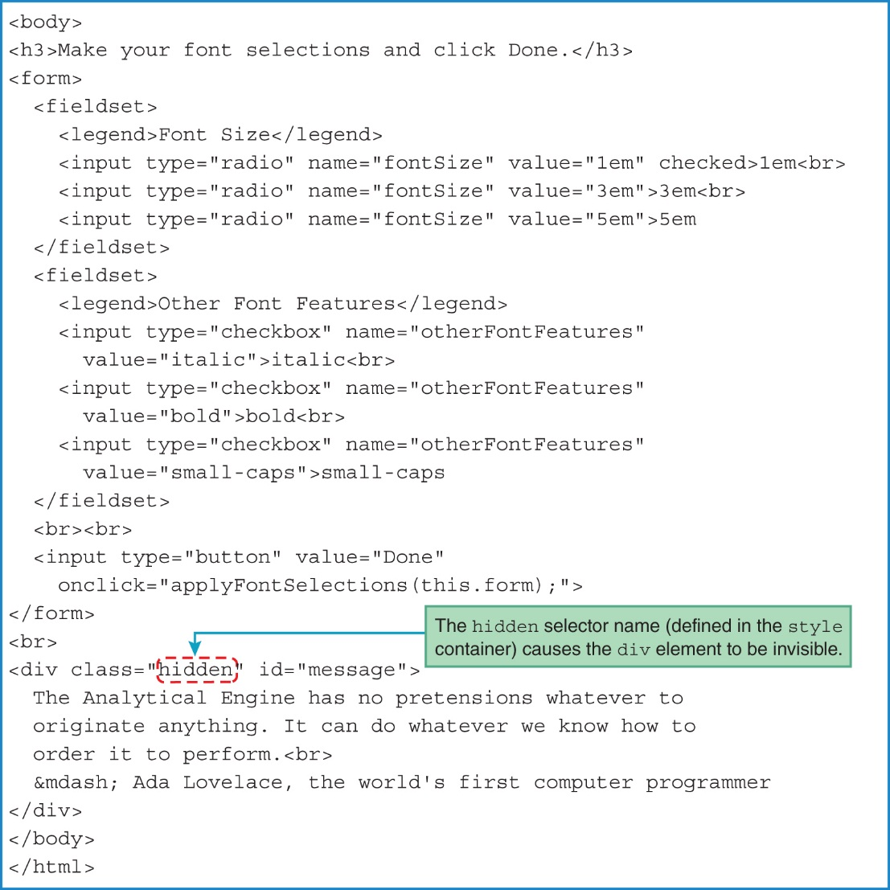
Manipulating CSS with JavaScript (3 of 4)

Slide 33
style Property
The style property accesses an element's style attribute.
Even when an element has no explicit style attribute, the element still has an associated empty style property.
Thus, for any element, you can use its style property to assign a CSS value to any of the element's CSS properties.
For example, in the Font Styles web page, we assigned the user's selected font size to message's style.fontSize property, where message stores the object associated with the p element at the bottom of the web page:
message.style.fontSize = form.elements["fontSize"].value;
Be aware that the style property is an object. As such, the style object has properties and methods. So in the code above, fontSize is a property of the style object.
Given the code above and the message.className = selectors; code shown earlier, if the user selects the 3em radio button and the bold checkbox, then it's as if this were the original p element code:
<p class="bold" id="message" style="font-size:3em;"> ... </p>

Slide 34
Manipulating CSS with JavaScript (4 of 4)
There are many ways to manipulate CSS using JavaScript.
In the Font Styles web page, for the checkboxes, we assigned a value to a className property. More specifically, we assigned italic, bold, and/or small-caps values (stored in a selectors variable) to message's className property:
message.className = selectors;
For the radio buttons, we manipulated CSS using a different JavaScript technique—we assigned a value to a property in an element's style object. More specifically, we assigned the user's selected font size to message's style.fontSize property:
message.style.fontSize = form.elements["fontSize"].value;

Slide 35
Using z-index to Stack Elements on Top of Each Other (1 of 5)
If you want to stack elements visually on top of each other, use absolute positioning to achieve the overlap, and use the z-index CSS property to determine the order of elements along the web page's z axis.
The z axis comes from the Cartesian coordinate system, where the x and y axes run horizontally and vertically, and the z axis runs from the monitor and towards the user's eyes.
If a web page element has a larger z-index value than another element, then the larger-valued element appears in front of the other element. "In front of" means closer to the user as the user faces the screen.
z-index values can be any integer value, positive or negative.
In this example, the arctic fox picture displays in front of the tiger picture:
.tiger {position: absolute; left: 0; top: 0; z-index: 0;}
.arctic-fox {position: absolute; left: 15%; top: 10%; z-index: 1;}

Slide 36
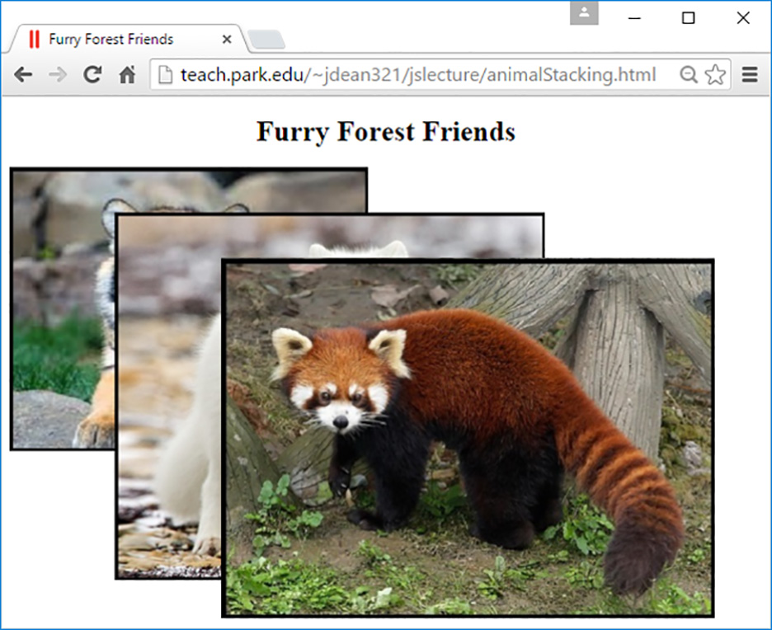
Using z-index to Stack Elements on Top of Each Other (2 of 5)
Note this web page with three pictures stacked on top of each other:

Slide 37
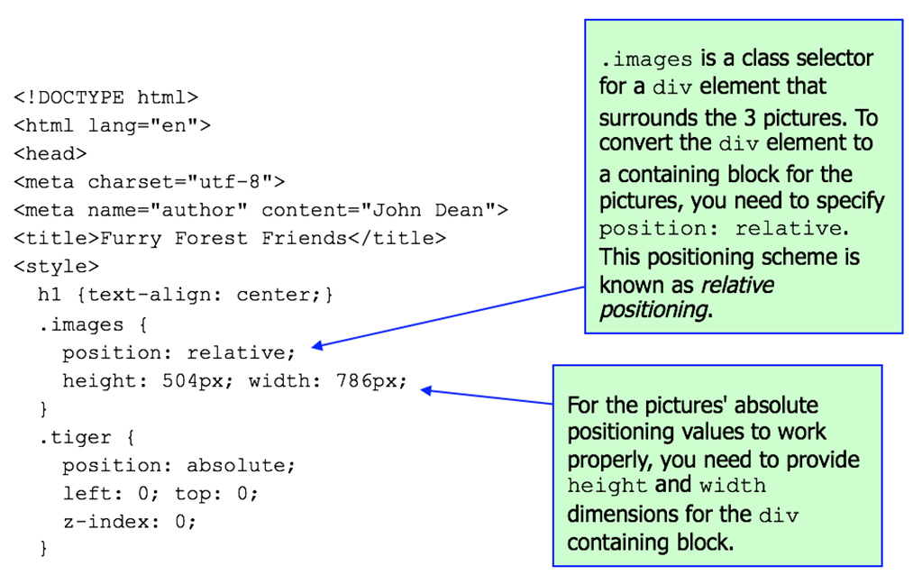
Using z-index to Stack Elements on Top of Each Other (3 of 5)

Slide 38
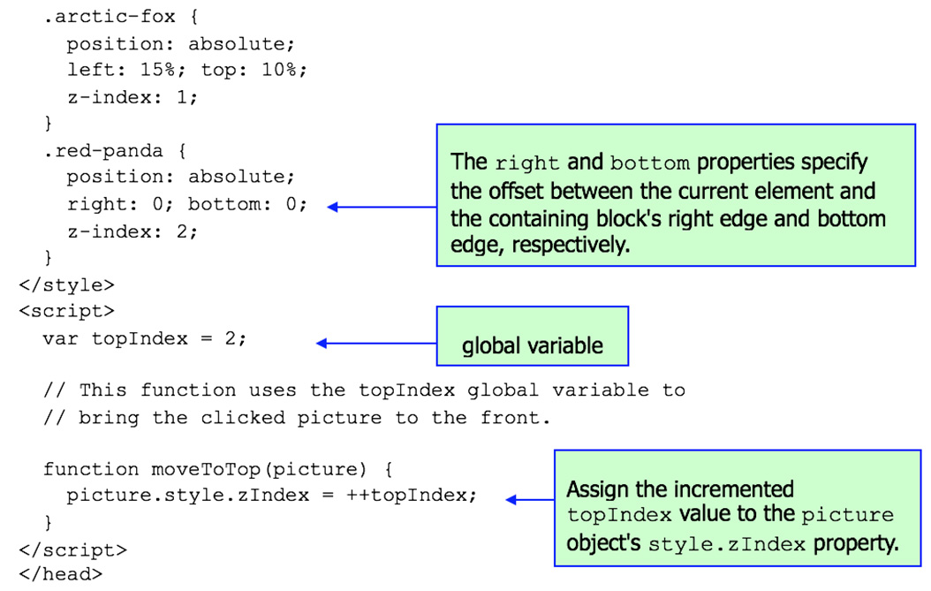
Using z-index to Stack Elements on Top of Each Other (4 of 5)

Slide 39
Using z-index to Stack Elements on Top of Each Other (5 of 5)
<body>
<h1>Furry Forest Friends</h1>
<div class="images">
<img src="../images/tiger.jpg" width="400" height="317"
alt="tiger" class="tiger" onclick="moveToTop(this)">
<img src="../images/arcticFox.jpg" width="480" height="411"
alt="arctic fox" class="arctic-fox"
onclick="moveToTop(this)">
<img src="../images/redPanda.jpg" width="550" height="403"
alt="red panda" class="red-panda"
onclick="moveToTop(this)">
</div>
</body>
</html>

Slide 40
Relative Positioning
In Chapter 5, you learned about absolute positioning, where you specify position: absolute in a CSS rule in order to position an element relative to the top-left corner of its containing block.
As an alternative, you can position an element relative to its normal flow within its surrounding content. That’s called relative positioning. Here’s the relative positioning rule from the animal stacking web page:
.images {
position: relative;
height: 504px; width: 786px;
}
The animal stacking web page has a div element that uses class="images". It serves as the containing block for the three pictures.
It’s not always necessary to specify height and width properties for a containing block, but depending on the situation, it’s very often helpful to do so. They are necessary for the animal stacking web page so the pictures’ absolute positioning values work properly.
Note the class selector rules for the three pictures.

Slide 41
Global Variables
If you declare (or even just use) a variable outside of all functions, that's a global variable.
A global variable's scope is the entire web page, so all functions share the global variable's value.
A global variable's persistence is as long as the web page is loaded, so if you call a function more than once, the global variable's prior value is retained.

Slide 42
Text Area Control, Pull-Down Menus, Popup Menus, List Boxes
Get content from 2012 chap 10 ppt
For popup menu details, see https://www.w3.org/TR/html51/interactive-elements.html#elementdef-menu

Slide 43
Chapter 10 - Quiz Questions
What word is syntactically required for the definition of a JavaScript submodule? (Note that "submodule" is the generic term for a method or function.)
function
method
subprogram
Which of the following correctly creates an array of 10 elements?
arr = [10];
arr = new [10];
arr = new Array(10);

